Slide 1
Coupon Monster
Cmpe 436 Term Project
Serkan Özel

Slide 2
Contents
Motivation
Project Features
Source Code
Demo

Slide 3
Motıvatıon
Discount coupons app
Good for advertisement
Compete while improving math skills
Shared resource -> Coupon solving screen
Actually, not a game but involves a game which makes it fun.

Slide 4
Project FEATURES
Coupon winning application
Gain coupons and scores by solving math problems
Compete with others
Default username and name, can change
Scoreboard
Coupons you win

Slide 5
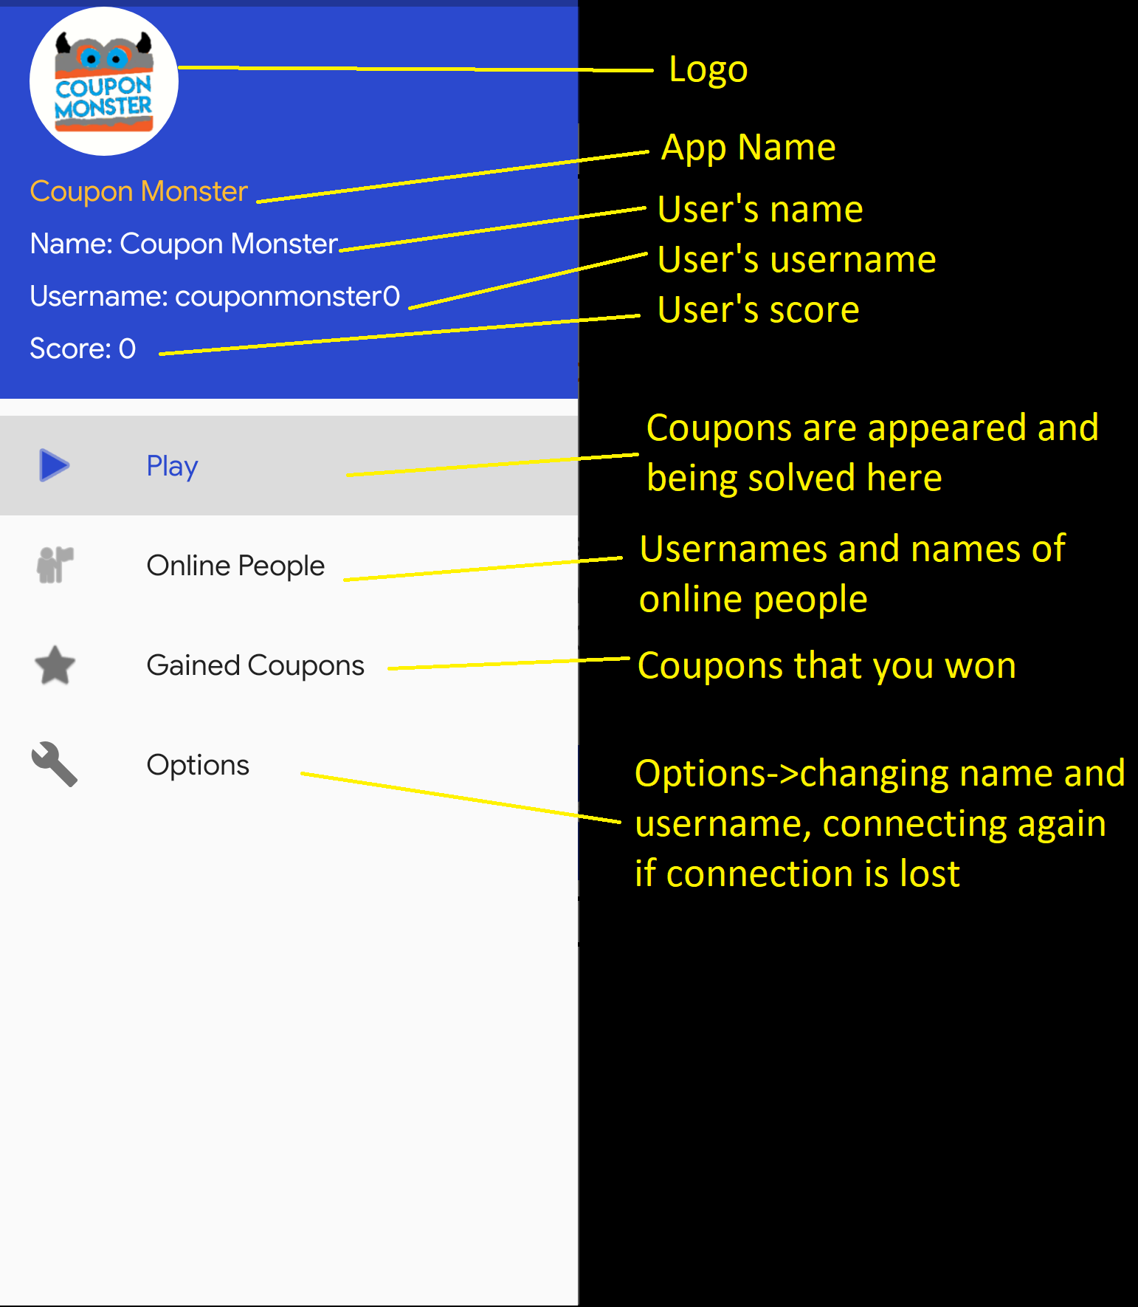
MENU

Slide 6
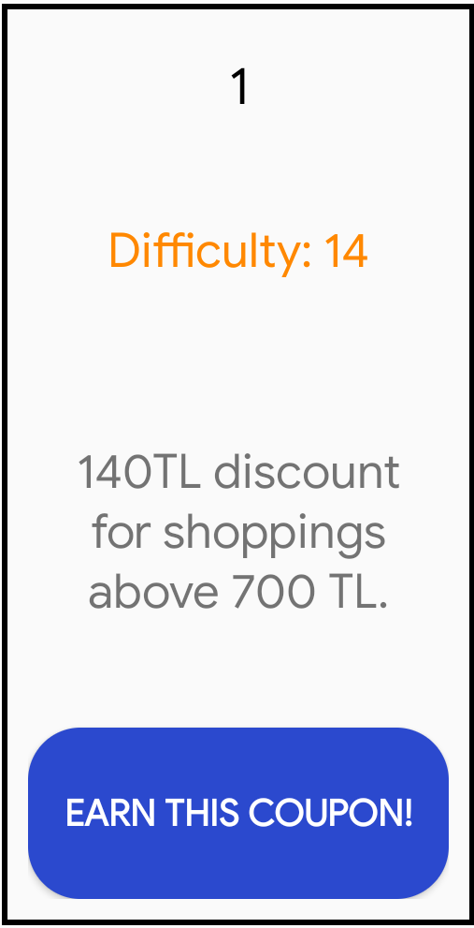
A Coupon
A coupon consists of:
Coupon Number -> Just for enumeration
Difficulty -> From 1 to 20
Coupon Text -> Text explaining the coupon
Discount -> (difficulty*10)
For shoppings above -> (difficulty * 50).’
Button to attempt solving the coupon problem

Slide 7
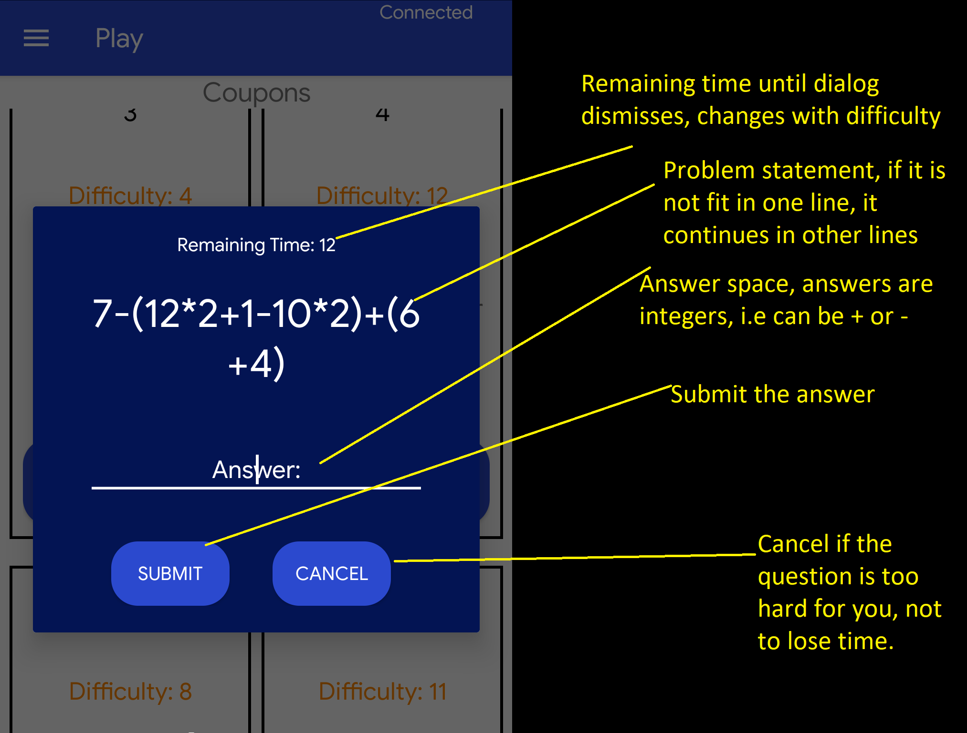
QUESTIONS

Slide 8
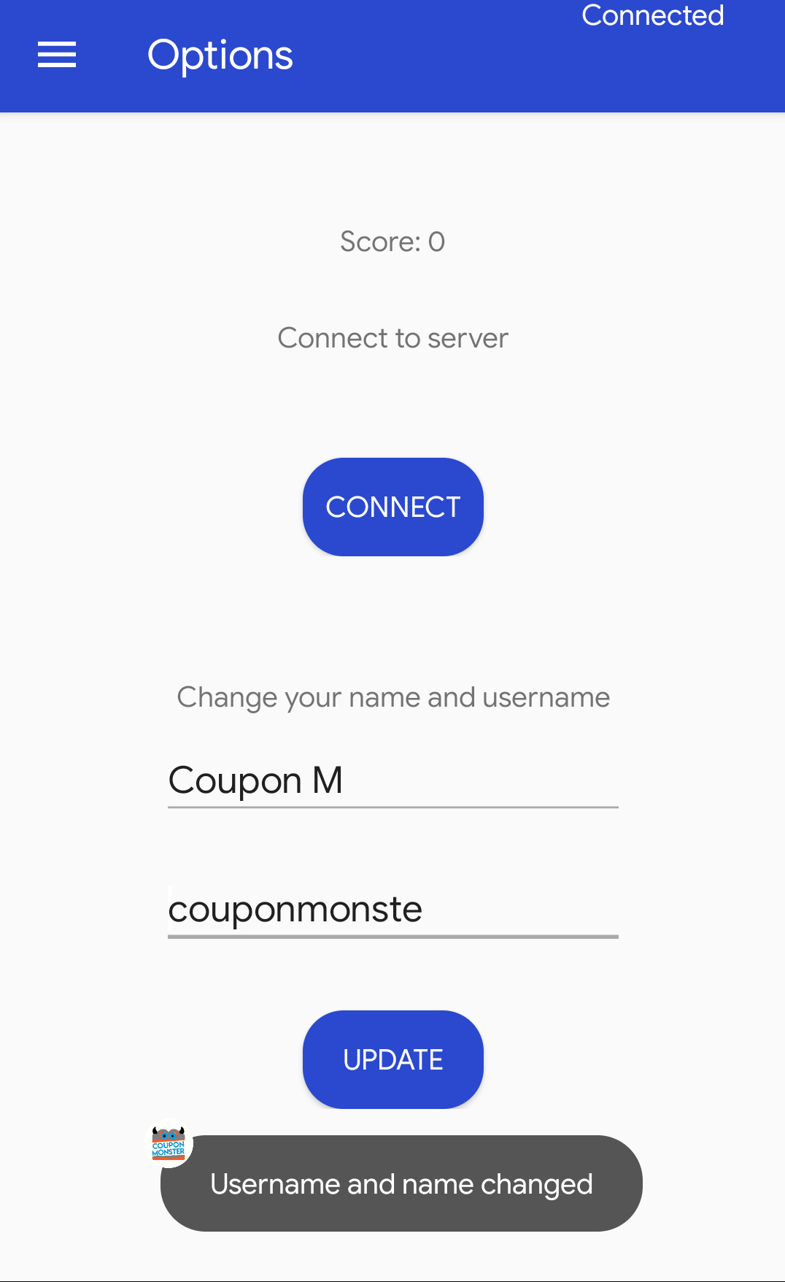
Toast Messages
Notifications shown to user are done via toast messages:
When someone earns a coupon -> username and coupon difficulty.
In online people tab, refreshing status.
Submission, submission result,
Username and/or name change result
Connect button -> Reconnecting result

Slide 9
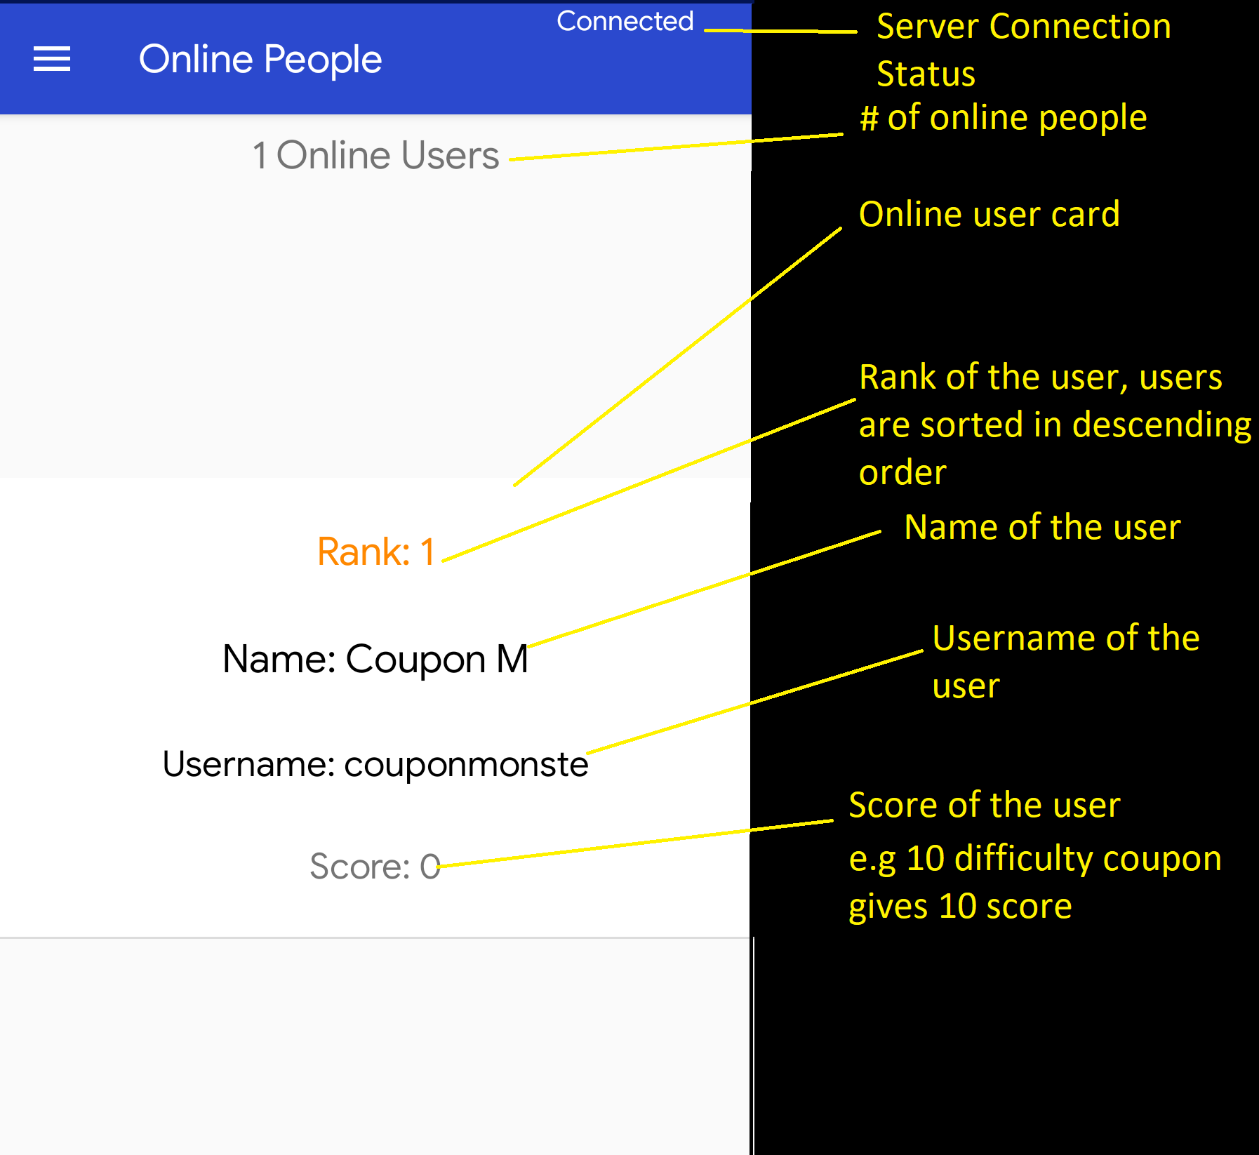
ONLINE PEOPLE

Slide 10
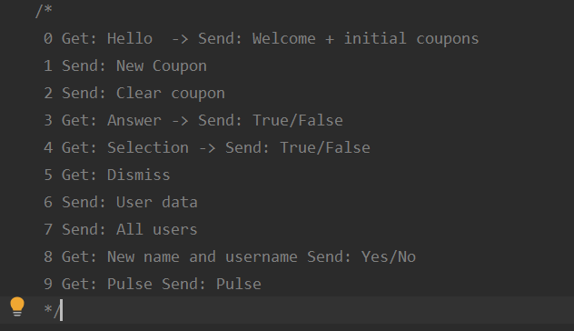
SOURCE CODE- BACKEND
Server starts a new thread for each connection.
Server message types:
1-Broadcast
2-Broadcast
3-Single
4-Single
5-Broadcast
6-Single
7,8,9-Single

Slide 11
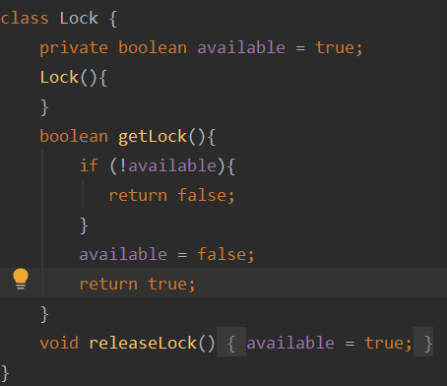
LOCK
Each coupon has a lock with it.
Frontend send a request for its communication thread to acquire lock of a coupon.
No waiting because a user does not want to wait a lot.
Instead if lock is not available inform user so that he or she continues.

Slide 12
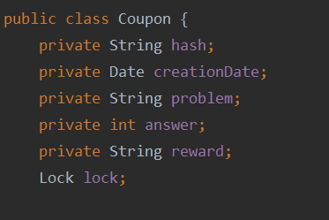
COUPON REPRESENTATION

Slide 13
RANDOM COUPON GENERATION

